Slide 1
Evidence of Evolution
I. The Fossil Record-
Fossils
Fossil record- a hisitorical sequence of life.
Vestigial structures- remnants of once-useful structures. Example- whale

Slide 2
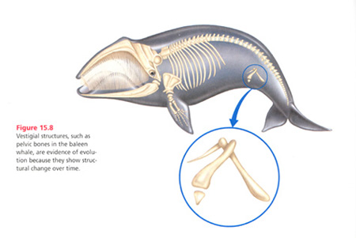
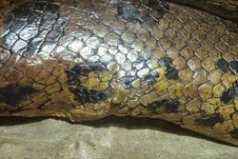
Vestigial Structures

Slide 3
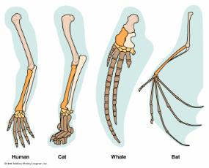
II. Comparing Organisms
Comparing Skeletal Structures
Comparing DNA from Different Species- all living things contain DNA
Comparing embryonic structures

Slide 4
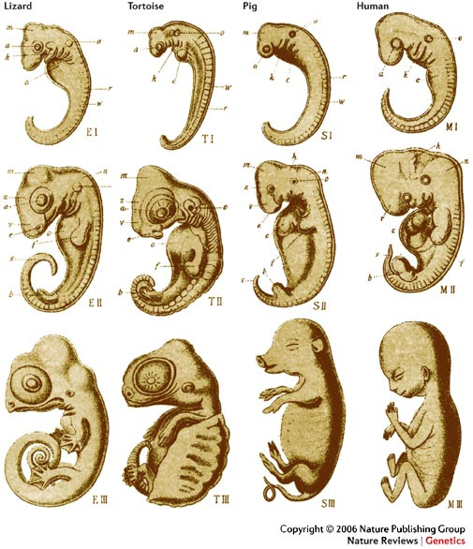

Slide 5
How does evolution happen?
Natural Selection
Overproduction- each species produces more offspring than will survive to maturity
Genetic Variation- individuals in a population are slightly different from one another (unique traits- size, color, and ability to find food).
Struggle to Survive- Competition
Successful Reproduction- The individuals that are well adapted to their environment will possess better traits for living in their environment, are more likely to survive and reproduce.

Slide 6
sponge
Using some of your chosen vocabulary words from yesterday’s reading, explain how organisms change over time.

